Slide 1
Change Management Communication Plan
Customisable Template
© TMS Consulting

Slide 2
Why use this template?
Change can be an uncomfortable process for employees and teams in any organisation. However, it is possible to turn that discomfort into excitement through effective planning, communication and leadership.
This template has been developed to help you create a simple and effective communications plan to engage employees and lead a successful transition to the future state.

Slide 3
Situation Statement
Firstly, provide a brief overview of the change – what is changing? what has brought about the change? what are the benefits of the change? This will help you stay focussed while building this plan.
[Insert Situation Statement here ….]

Slide 4
Stakeholder Identification
In order of priority, map out the important parties affected by the change … this could be staff, customers, a particular department etc.
Stakeholder Name/Group 1 – include a short sentence on how they will be affected
E.g. Employees in the Administration team will need to use a new system for recording client interactions

Slide 5
Key Messages
Develop a number of key messages that will help you and your team deliver clear and consistent communication and help staff and stakeholders understand and embrace the change. Keep each message short and to the point.
Key message 1
E.g. “This change will make us a paper-less organisation which will mean more efficient process and less environmental waste”

Slide 6
Channels
What will be the best way to reach your key stakeholders? This could include email, newsletters, posters, flyers, intranet, website etc.
An intranet site will be developed with information about the change
A letter from the CEO will be distributed to all relevant external stakeholders

Slide 7
Project Team - Roles and Responsibilities
What does your communications team look like and who is responsible for what?
E.g. Peter Philips, Comms Manager
Sales Team
Email, Newsletter
Name, Position
Stakeholder Group
Channel
Channel
Stakeholder Group
Name, Positon
Name, Position
Stakeholder group
Channel
Name, Position
Stakeholder group
Channel
Channel
Stakeholder Group
Name, Positon

Slide 8
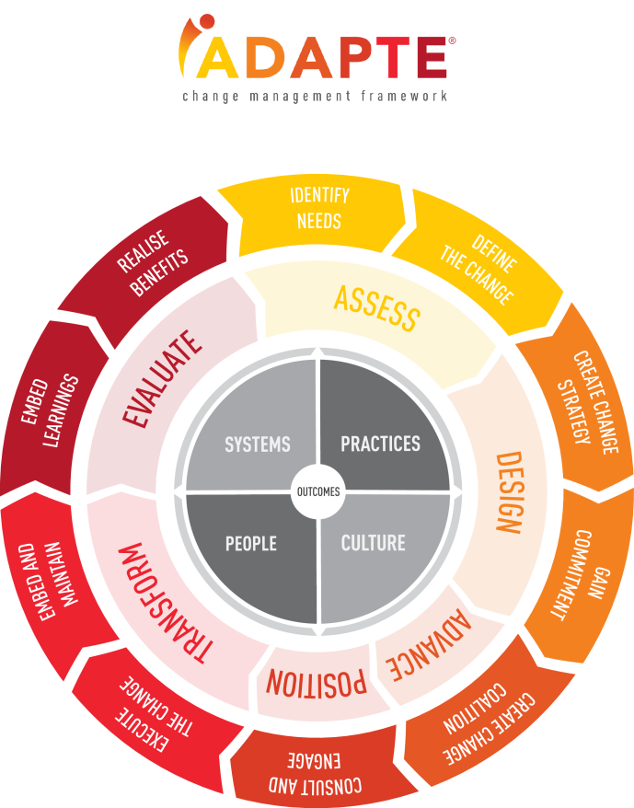
Scheduling - Change Project Stages
Now it is time to bring it all together …
On the next page is a scheduling template that will help you set out the timing of communications and provide a detailed summary of your key activities.
TIP: iADAPTE® helps to sequence and categorise these in project stages. In this template we have utilised iADAPTE’s six stages of change management.
Find out more at www.iadapte.com

Slide 9
Schedule
Activity | Stakeholder Group | Interest | Messages | Channels and Activities | Stakeholder Owner | Timing
Stage 1: Assess
1. Activity… | All | ??? | What are the key messages to be communicated | How is it going to be communicated | Who is responsible for making it happen | Due Date - when will the communication happen
Stage 2: Design
Stage 3: Advance

Slide 10
Schedule cont’d …
Activity | Stakeholder Group | Interest | Messages | Channels and Activities | Stakeholder Owner | Timing
Stage 4: Position
1. Activity… | All | ??? | What are the key messages to be communicated | How is it going to be communicated | Who is responsible for making it happen | Due Date - when will the communication happen
Stage 5: Transform
Stage 6: Evaluate

Slide 11
Good luck!
All the best with your upcoming change initiative.
If you have any questions or would like to setup an initial consultation with one of our change specialists, please email us at solutions@tmsconsulting.com.au or give our head office a call on 07 3003 1473.

